Slide 1
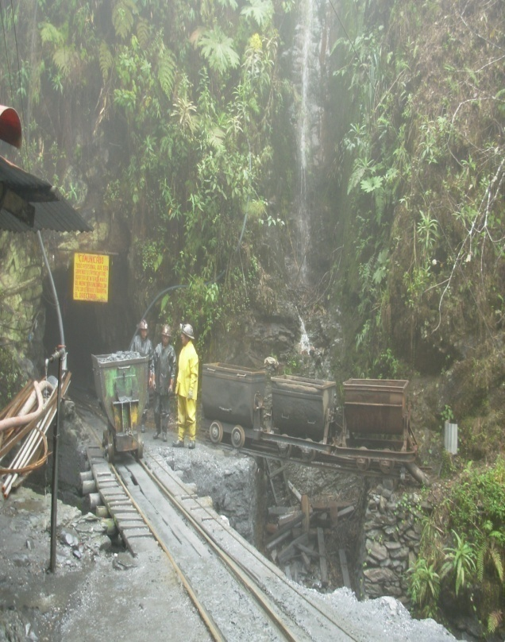
Daniel Lafuente
Cumbre del Sajama
Bolivia – South America
CHALLENGES AND OPPORTUNITIES FOR THE FAIR TRADE PROJECT IN GOLD: COTAPATA MINING COOPERATIVE
Seventh annual meeting CASM - Mongolia

Slide 2
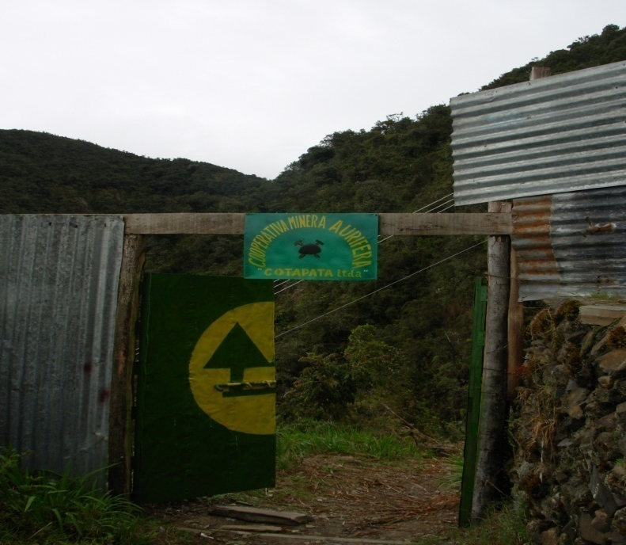
CONTENT
Daniel Lafuente

Slide 3
CONTENT
Cumbre del Sajama – Proyecto Comercio Justo
Brief History
General Data
Production process
Commercialization
Challenges
Opportunities

Slide 4
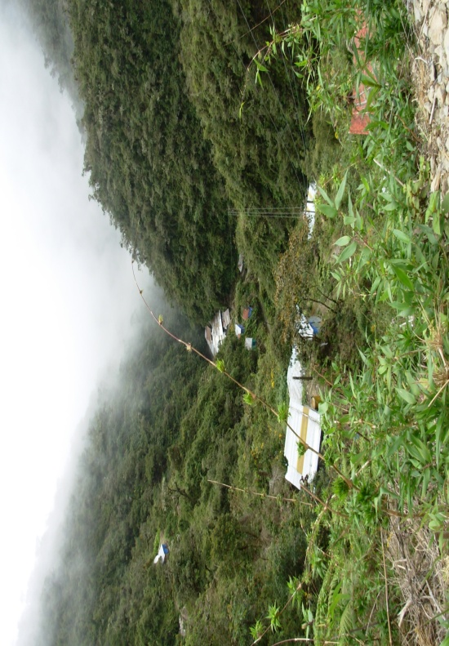
BRIEF HISTORY
Cotapata - Bolivia

Slide 5
BRIEF HISTORY - COTAPATA
Cotapata - Bolivia
Antiquity of the mine
Actual concessionaries (land owners)
Protected area
Selection process for fair trade project
Established partnerships for this project

Slide 6
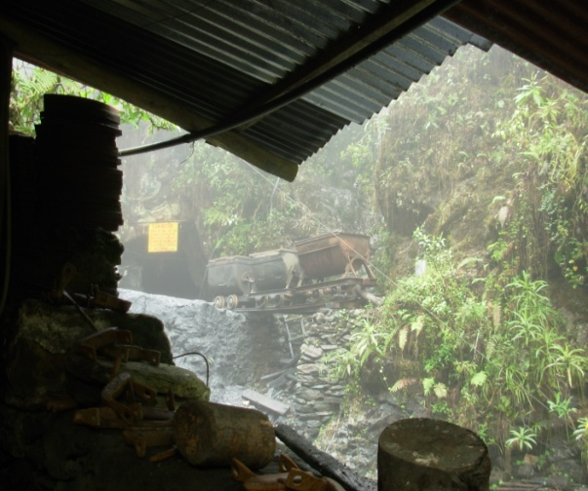
Séptimo Encuentro CASM - Mongolia
GENERAL DATA
Daniel Lafuente

Slide 7
GENERAL DATA
Cumbre del Sajama – Proyecto Comercio Justo en Oro
Location - La Paz, Nor Yungas.
Altitude - 2800 Mts. (Above sea level)
Access to the mine - Road (by car) then a long walk (Path)
Production- Gold - Purity between 85% to 90%.
Average amount produced per month - 2 Kilos
Number of workers
Actual Salary for the workers

Slide 8
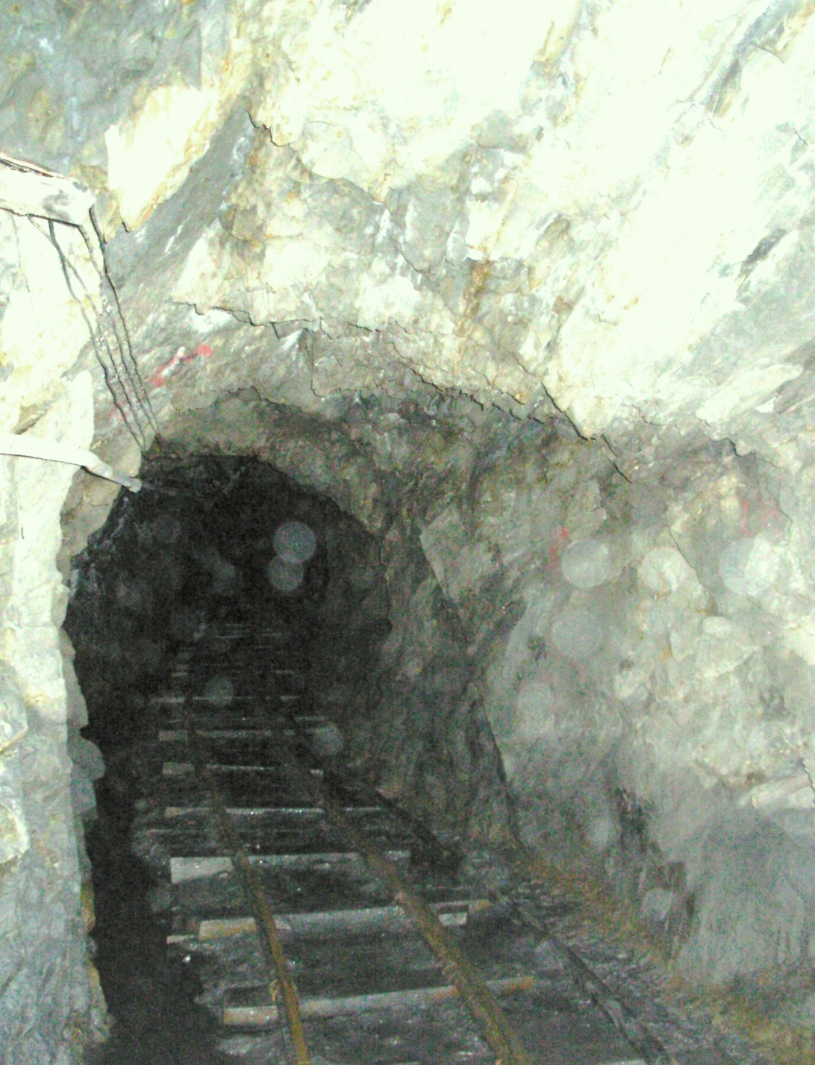
PRODUCTION PROCESS
Cooperativa Minera Cotapata
Underground mining.- The extracting work is realize trough an approximately 600 meters profundity tunnel. They use dynamite to blow up of the rock.

Slide 9
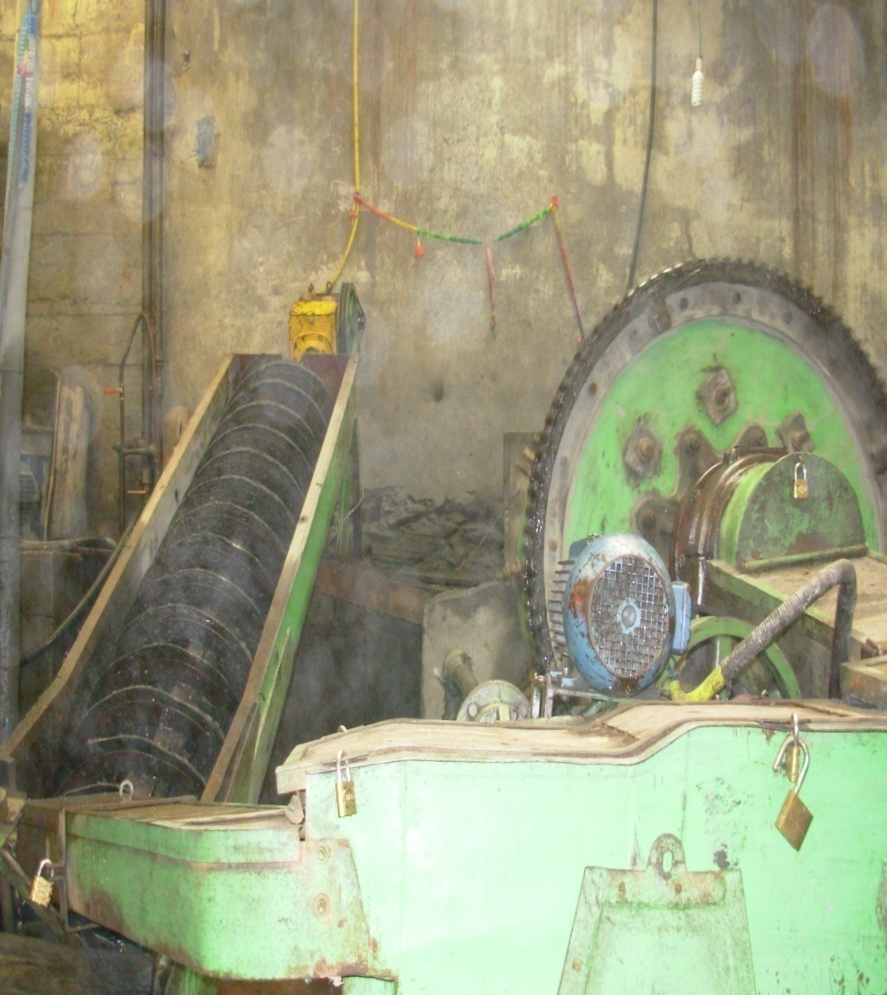
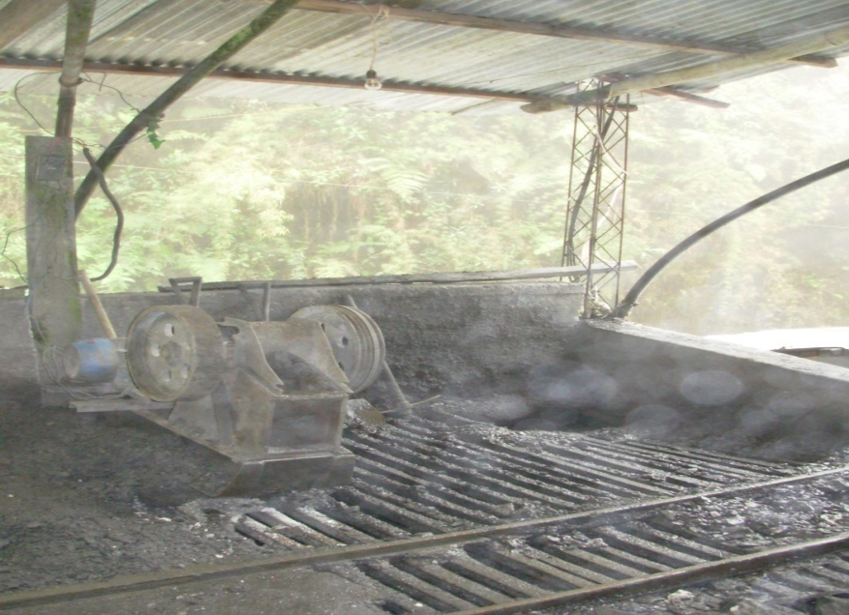
PRODUCTION PROCESS
Cooperativa Minera Cotapata
Jaw Crusher – Used to crush and separation of the extracted rock.
Jig (“Denver mineral jig”)

Slide 10
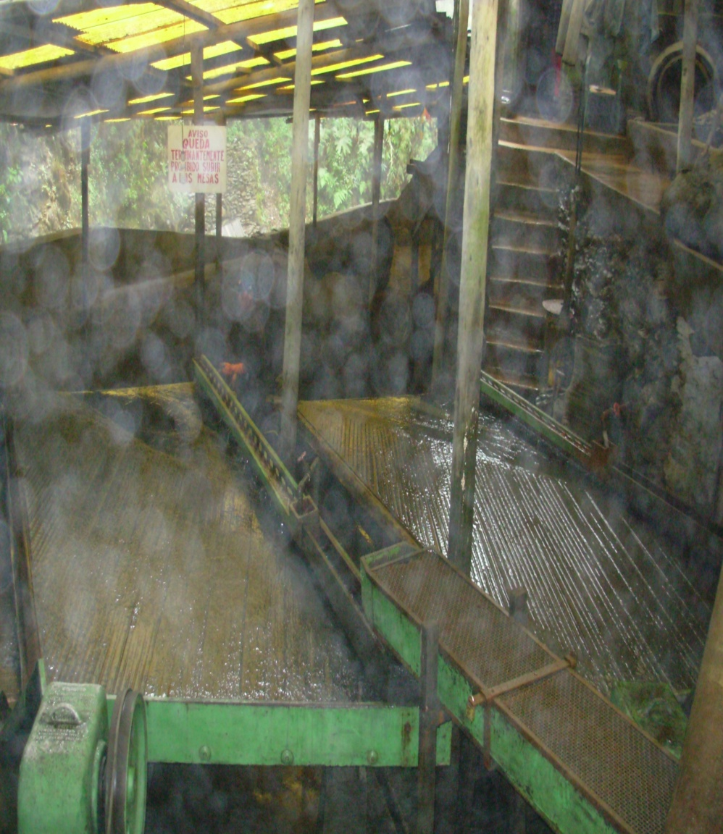
PRODUCTION PROCESS
Cooperativa Minera Cotapata
Concentrating tables.- After the use of the jig, the mineral passes trough the concentrating tables.

Slide 11
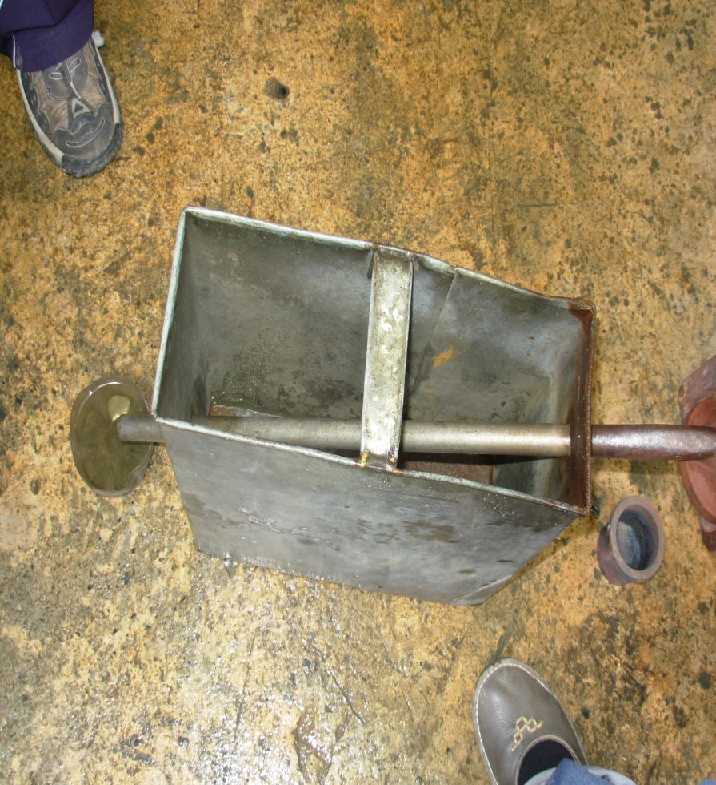
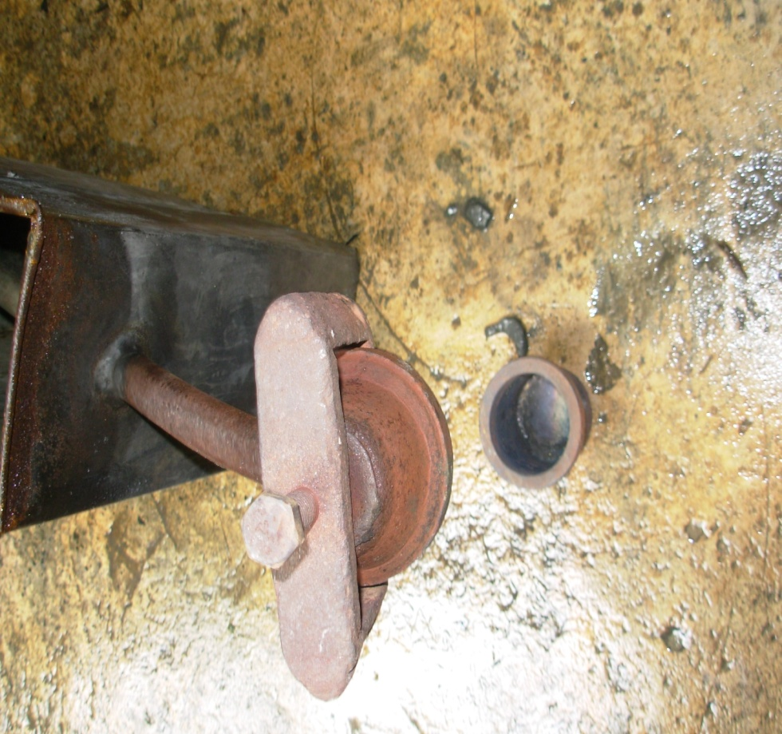
PRODUCTION PROCESS
Cooperativa Minera Cotapata
Cotapata miners use mercury in the process.
They process the gold using the “retort”
Through closed circuit – This cooperative salvages and reuses mercury

Slide 12
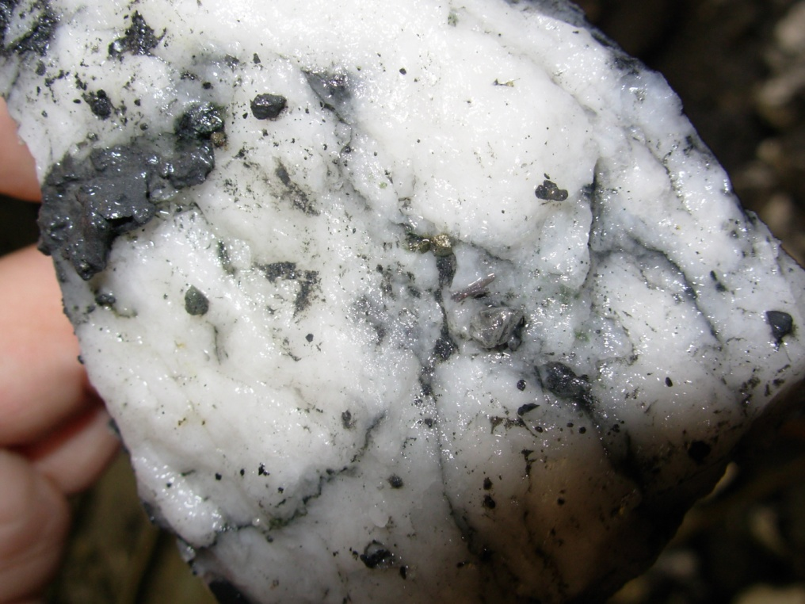
TRADE – COMMERCIALIZATION
Cooperativa Minera Cotapata

Slide 13
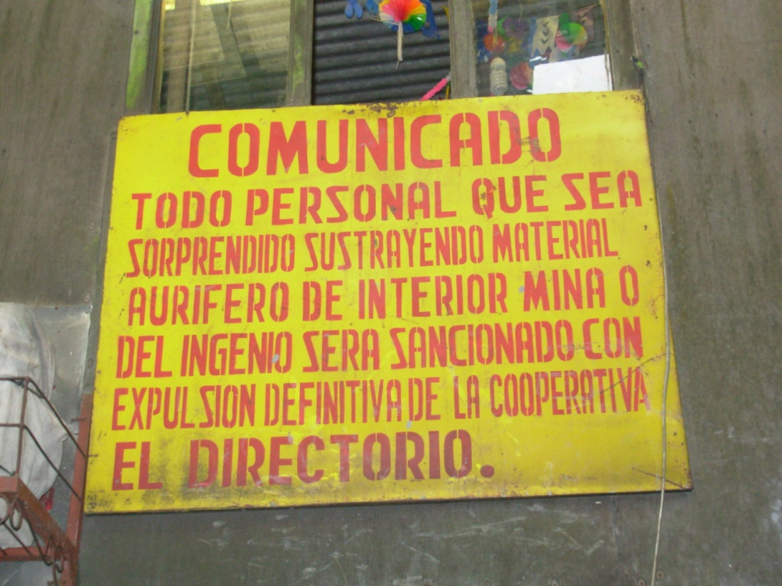
Trade - commercialization
Cumbre del Sajama – Comercio Justo en oro
Average production per month
Buyers - Clients
Sale price
Type of gold - Ingot
Purity ( “ley” )
Taxes

Slide 14
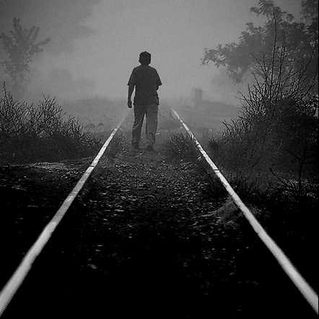
CHALLENGES AND OPORTUNITIES
DANIEL LAFUENTE
PROYECTO COMERCIO JUSTO
COOPERATIVA MINERA COTAPATA
BOLIVIA

Slide 15
Challenges for the fair trade project in COTAPATA - BOLIVIA
Educating the miners from Cotapata about the benefits of this project for them and their families.
Using practical and participative tools to qualify the miners.
Establishing long term relationships with the miners from Cotapata.
Maintaining the expectations and interest of the miners.
Being able to establish long term alliances with the buyers (jewelers) – Being able to achieve buyers´ requirements.
Applying ARM´s standards in approximately one year, including formalizing the payment of taxes by Cotapata cooperative
Being an example to other gold mining cooperatives in Bolivia trough this pilot project in Cotapata.

Slide 16
OPPORTUNITIES FOR THE MINERS IN BOLIVIA
To improve environmental, labor, social and economical development
Higher revenues for the miners to reinvest in the cooperative and the community
To establish strong and long term alliances with jewelers from Europe and other potential markets
Jewelry elaboration in the country helped by European designers
To formalize the mining cooperative´s activities (organization level, tax payment, accountability)
The conversion of small scale miners into small entrepreneurs with social and environmental conscience
To shorten the commercialization chain of Bolivian gold

Slide 17
THANK YOU !! GRACIAS !! emails: danlafuar@gmail.com sajama@acelerate.com

