Slide 1
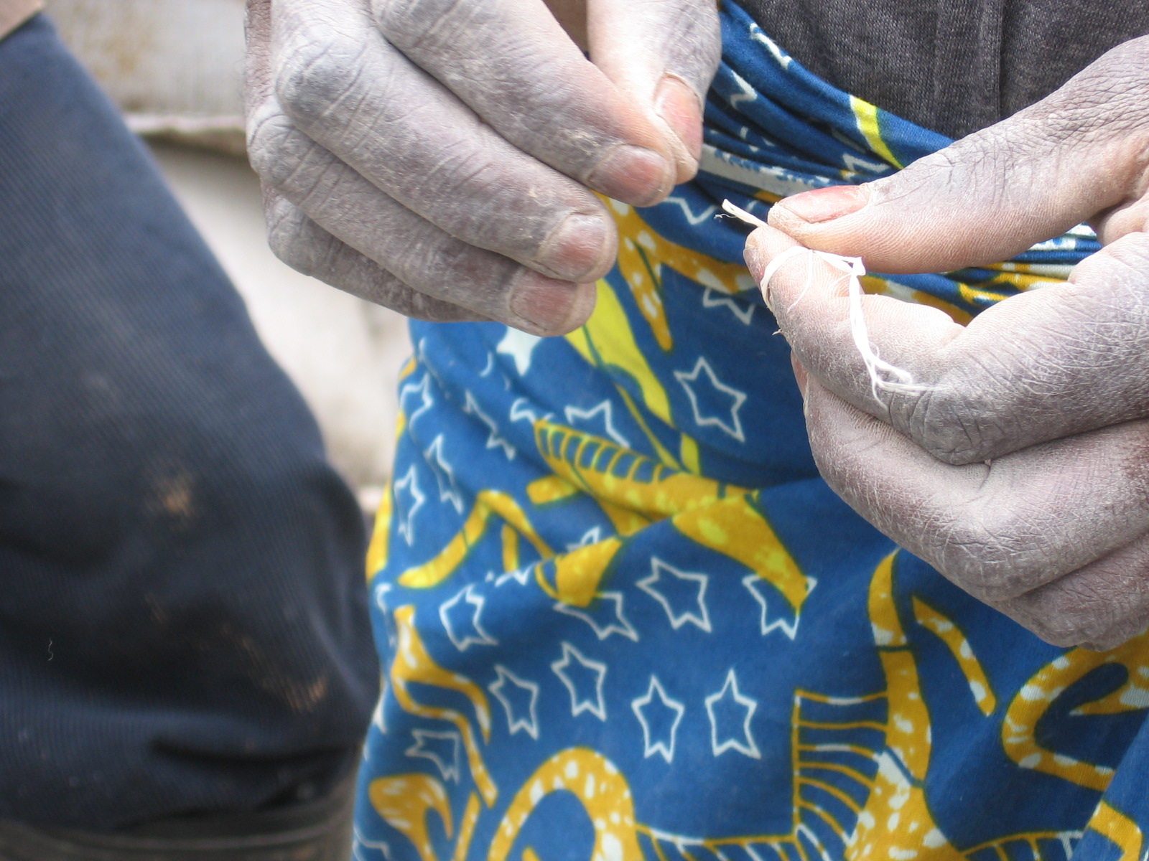
Dr Nellie Mutemeri
CASM Pre-conference Workshop
6th October 2006
Sustainable Livelihoods:
A Gender Sensitive Approach

Slide 2
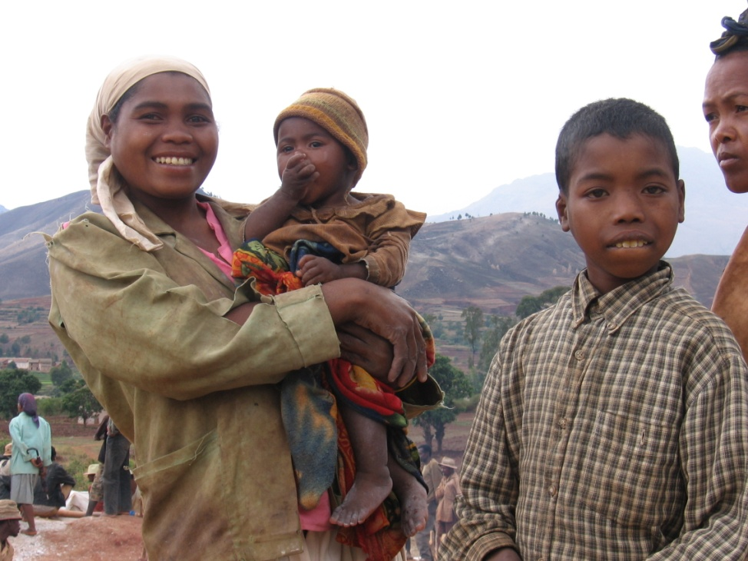
Outline of presentation
Introduction
  Objective of the presentation
Issues and Concepts
Why a gender sensitive approach?
A Strategic approach

Slide 3
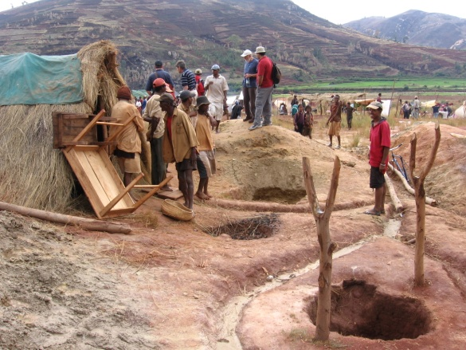
Introduction
Objective of the workshop
  Explore opportunities to enhance sustainable livelihoods through a gender sensitive approach.
Millennium Development Goals (MDGs)
  Goal 1: Eradicate extreme poverty and hunger
  Goal 3: Promote gender equality and empower women

Slide 4
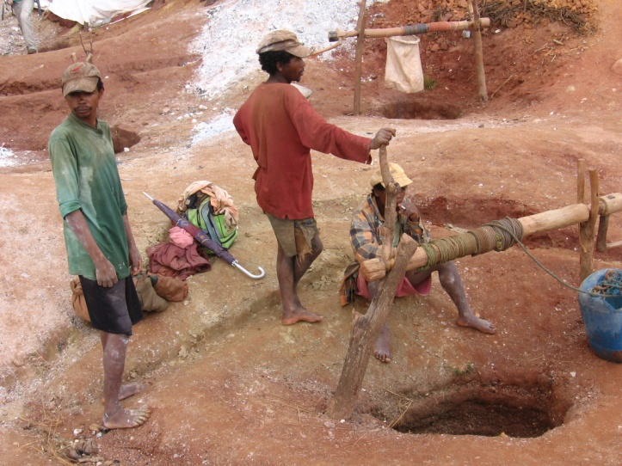
Issues and Concepts
Roles of people impacted by mining
Sustainable livelihoods
Gender sensitive approach
Social issues associated with mining

Slide 5
Issues and Concepts
Participants
Affected Communities
Sustainable Livelihoods
ASM
Gender sensitive approach
LSM

Slide 6
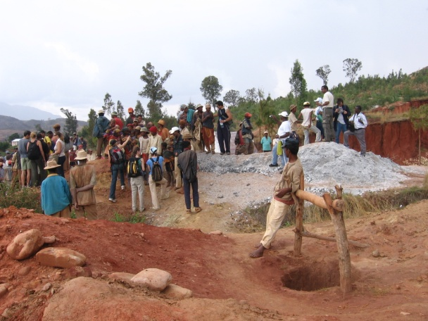
Roles of people affected
  Participants in mining operations:
    Operators, employees, buyers, suppliers etc.
  Communities affected by mining:
    In the immediate surrounds of the mine
    Labour sending areas
    Global, Provincial, National & Local
Issues differ with the size/type of the operation
  ASM – dominated by informal activities
  LSM - formal (includes medium-scale)

Slide 7
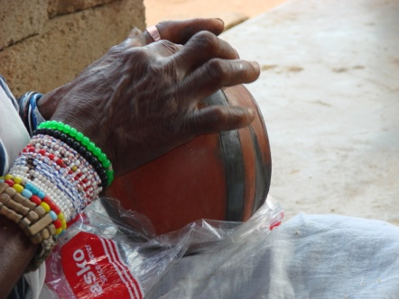
Challenges associated with ASM
  Unequal access to mineral resources
  Unfair labour practices and exploitation of women
  Child labour, particularly of girls
  Disruption of social structures
  Environmental impacts (i.e. biophysical)
  Illegal trade
  Poor access to support services; i.e. technology, funding, markets, skills etc
  Association with conflict

Slide 8
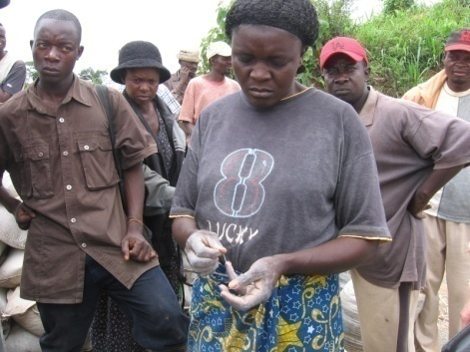
Sustainable Livelihoods
Components of a Livelihood:-
  Assets
  Activities
  Entitlements
A livelihood is sustainable when it allows one to make a living now without compromising the ability of others to make a living now and in the future
  Sustainable livelihoods can be seen as a goal that communities wish to attain
  Sustainable livelihoods approaches support interventions that lead to sustainable development by putting communities at the centre of process, about how they attain their livelihood goals

Slide 9
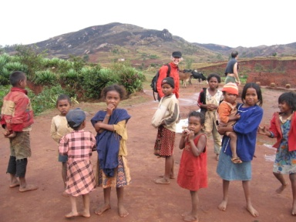
Gender Sensitive Approach
Analyse the different needs, challenges and opportunities for men and women
Interventions should be structured in a way that recognises the inequalities
Ensure a process of improvement and continuous learning through evaluation and monitoring; and impact assessment
A gender sensitive approach recognises that women and men are different both in terms of sex and gender.
Due to these difference women and men in all societies are valued differently and have unequal access to information, resources, services, opportunities etc.

Slide 10
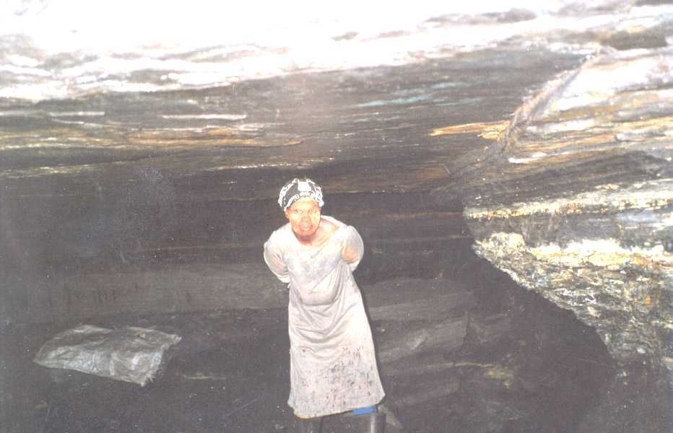
Social Issues in The Mining Industry
Consultation
Infrastructure provision
Labour
Environmental impacts

Slide 11
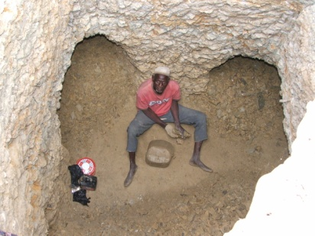
Social Issues in The Mining Industry (1)
Consultation:-
  Involve women, and empower them to participate fully and equally with men
  Consultation during policy and legislation formulation » » Communities’ needs enshrined in enforceable instruments
  Consultation during the lifecycle of a mining project » » Decision in allocation and utilisation of benefits etc.

Slide 12
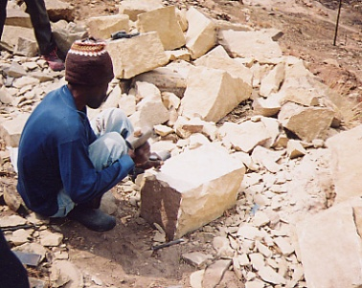
Social Issues in The Mining Industry (2)
Infrastructure provision:-
  LSM associated with infrastructure provision
  Communities capacity to participate in building and maintenance is paramount for sustainability
  Women and men should be equally involved in the “what, where and by whom” processes of infrastructure provision

Slide 13
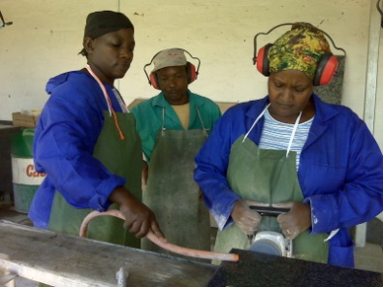
Social Issues in The Mining Industry (3)
Labour:-
  Impact of migrant labour on “hinterland” communities – influx of men
  Impact of migrant labour on labour sending areas – male family heads leaving
  Issues include; prostitution, HIV/AIDS, crime, pressure on resources (i.e. water, energy, land etc.), breakdown of social structures
  Alternative livelihoods on mine scale-down and eventual closure

Slide 14
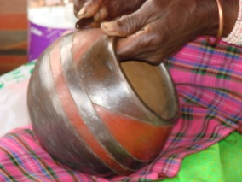
Social Issues in The Mining Industry (4)
Environmental impacts:-
  Biophysical impacts of mining e.g. pollution (water, air, noise), deforestation etc.
  Women as primary care givers are more vulnerable to negative impacts like pollution of clean water sources, disease caused by the poor sanitation etc.
  Involvement of both and women in conservation, rehabilitation etc.

Slide 15
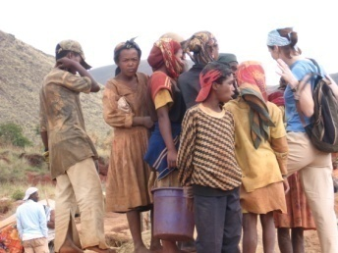
Why a gender sensitive approach? (1)
Recognizing that women and men have unequal access to opportunities.
Major social structures are dominated by men who may be driven to the following forms of resistance to change; hostility, tokenism, trivialisation, sabotage etc.
Recognizing that women need men’s support to achieve gender equality, and ultimately to make sustainable development attainable.
Appropriate approaches and tools are derived to ensure the goal of sustainable livelihoods is achieved for the community.

Slide 16
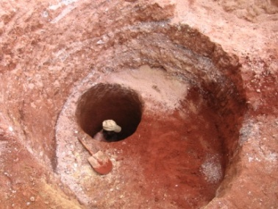
Why a gender sensitive approach? (2)
Opportunity to sensitise men and make them aware of the negativity of marginalizing women
Men educated about how gender equity can be good for the socio-economic sustainability of communities
Opportunity for women to understand men’s mindsets and thereby working with them for change.

Slide 17
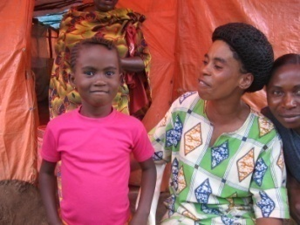
A Strategic Approach
Gender issues highlighted in the Mongolia Workshop. September 2008:-
  Research to understand the issues better, and development of guidelines etc.
  Information disbursement, awareness building for all stakeholders
  Learning, (both in the “gender sensitive approach” and technical training on issues such as safer technologies etc)
  Practical assistance for access to finance, fair trade, technology, skills etc.
  Organisation at a local level and at global level for networking and information sharing
  Advocacy

Slide 18
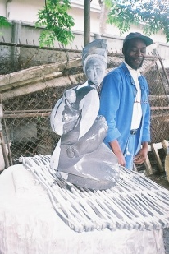
A Strategic Approach
Key Questions
  Do sustainable livelihoods & gender sensitive approaches mean the same thing to all stakeholders?
  How can the “sustainable livelihoods” and “gender sensitive” concepts work in the context of the mining industry?
  What policies are needed to ensure that sustainable livelihoods interventions implemented by mining companies support gender equity?
  What challenges are faced by industry professionals trying to ensure a gender sensitive approach in their work practices?
  What can be learnt from the communities that should be at the centre of the sustainable livelihoods approach?
  What is the global approach (best practice) on “sustainable livelihoods & gender sensitive approaches” ? What of the future?

Slide 19
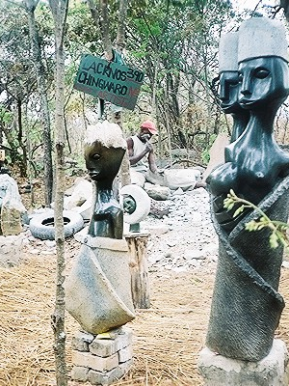
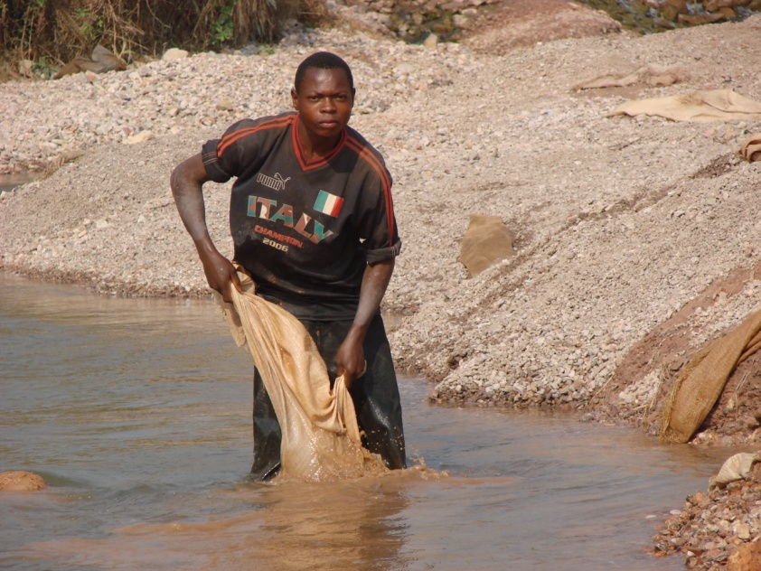
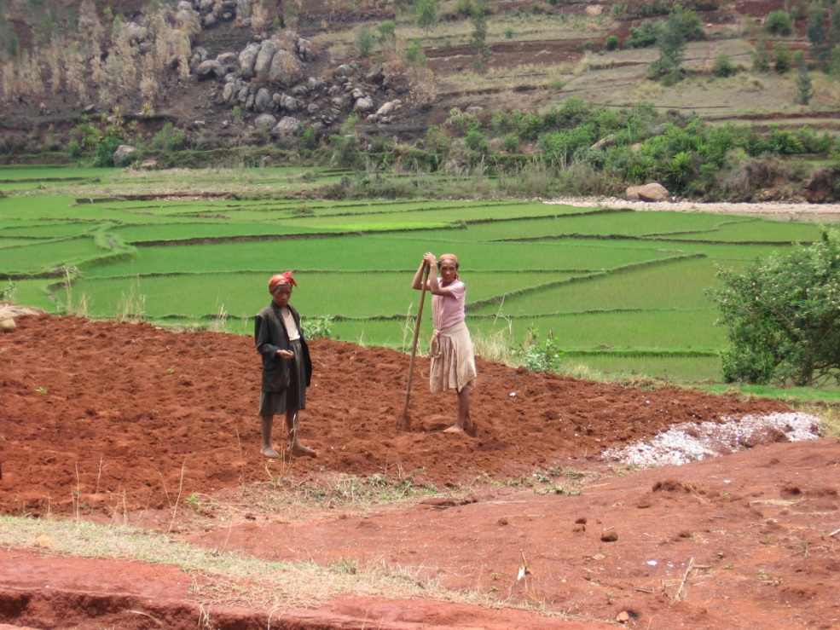
Thank You

